Slide 1
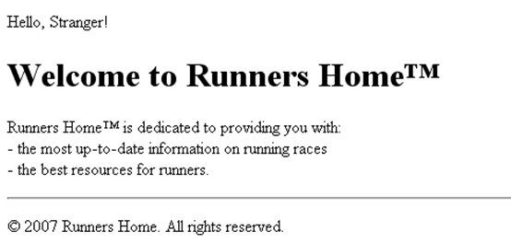
Write an HTML page like the following:
* Use headings and divs

Slide 2
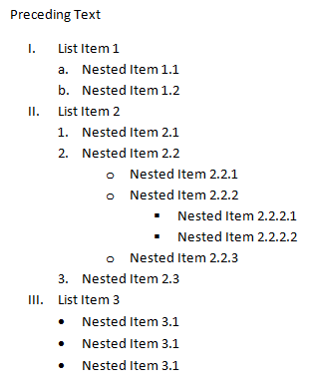
Exercises (2)
Write an HTML page like the following:

Slide 3
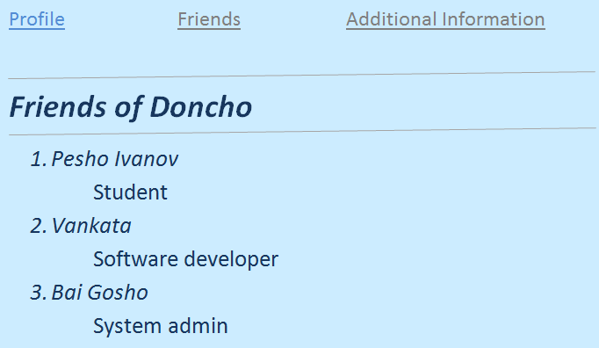
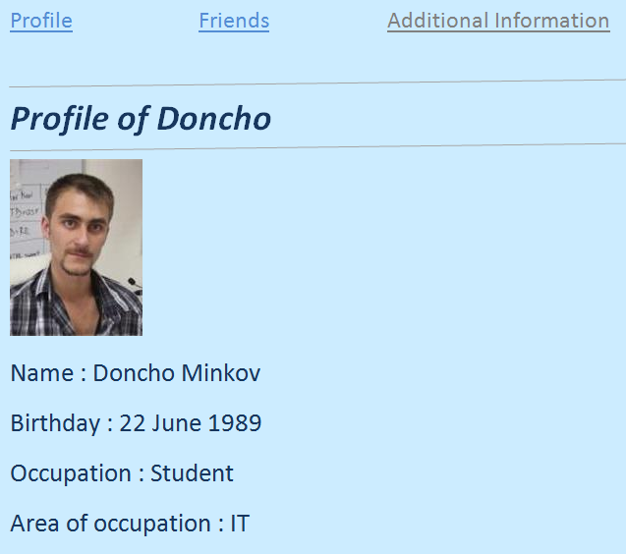
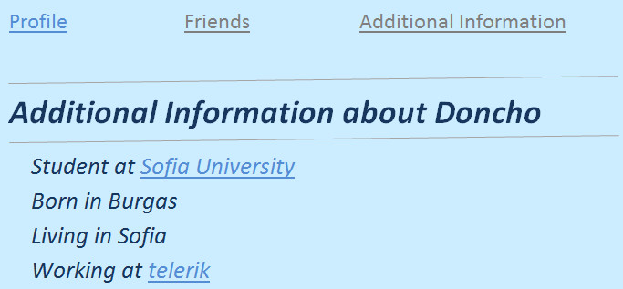
Exercises (3)
Create an user profile Web page Profile.html, friends page named Friends.html and info page named Info.html. Link them to one another using <a> tag

